Slide 1
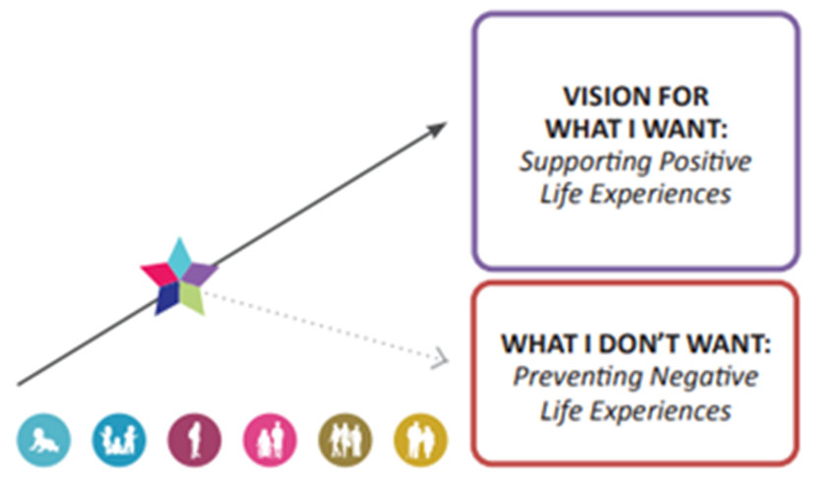
Improving Lives through Services and Supports
An Introduction to Charting the LifeCourse (CtLC) Trajectory Tool for Planning
Presented by:
Jan Lampman, Community Drive
Tracy Vincent, MI DD Council
Notes:
Today Jan Lampman and I are going to be presenting on Improving Lives through Services and Supports using the Charting the LifeCourse lens.

Slide 2
AGENDA
Brief Overview of Charting the LifeCourse Principles
CtLC Planning Tool: Trajectory
Person-centered Practice Learning Community
Additional Resources
Notes:
The agenda for today: We are going to provide a very brief overview of the Charting the LifeCourse framework with a specific focus on one of the principles and tools called the Trajectory. SO we are explaining what the trajectory is and sharing several examples on the variety of ways it can be used in helping people plan for their good life.
We will also be sharing an opportunity for CMHSPs to apply for the Person-centered Practice Learning Community.
End with some additional resources for you.

Slide 3
What is Charting the LifeCourse
Framework created for all people and families of all abilities and ages to:
Develop a vision for a good life (share ideas, hopes & fears)
Explore possibilities
Have difficult conversations
Set higher expectations
Navigate the future
Problem-solve, plan and communicate
Explore a variety of supports
Notes:
A way to explore all of the possibilities for individuals and families – and being creative and thinking outside of the box
It’s a way to help work through having those difficult conversations
It’s a framework that encourages setting higher expectations for people and supporting people to reach their full potential

Slide 4
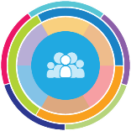
Core Belief
All people and their families have the right to live, love, learn, work, play
and pursue their life aspirations in their community.
Notes:
Charting the LIfeCOurse is for anyone – this is not a separate framework for people with disabilities. – everyone is included in this core belief.

Slide 5


Focusing on the All
All people, regardless of age, ability or family role, are considered in our vision, values, policies and practices for supporting individuals and families. All families have choices and should have access to the supports they need.
Notes:
The framework focuses on the All. All people are considered in the vision, values, policies and practices regardless of age, their ability, or what life stage they are in.

Slide 6


WHY We Must Think Differently About Supports
75%
25%
ONLY 25% OF PEOPLE WITH IDD ACCESS FORMAL OR PAID SUPPORTS WITHIN THE DD SYSTEM
WHAT ABOUT THE OTHER 75%?
Notes:
And to expand on that a little further - On a national level, Only about 25% of people access formal or paid supports within the DD System.
BUT What about the rest? What about the other 75%? How do they have good lives? How do systems of support consider ALL people with IDD and families when making policies and improving practices?
The framework supports the All

Slide 7
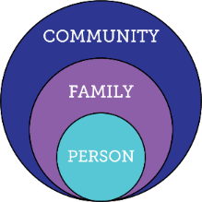
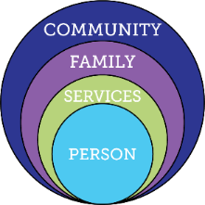
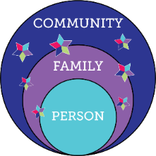
Services and Supports are Evolving
Everyone exists within the context
of family
and community
Traditional
Disability Services
Integrated Services and Supports within context of person, family and community
Notes:
WE know that services and supports continue to evolve.
Looking at the circle on the left – as an individual you have family and friends and are part of a community – we all exist within the context of our family and community.
Think about where we are headed with the framework the idea is about building on those 3 circles.
Look at the circle in the middle and see the green circle that represent services – sometimes, with the best intentions, those services are wrapped so tightly around the person that it cuts them off from family, friends and community. SO Even though we’ve Come a long in the way we offer supports and services, we still need to challenge ourselves – are the services and supports we are offering are they a barrier to providing connections to family and comm or are the supports being offered creating a meaningful life people want to have.
Look at the Circles on the right hand side – this is the visual image that we use when we are thinking about where are we headed with this framework – where the person exists within the context of their family and community but have integrated supports and services only when and where needed.

Slide 8

Person in the Context of Family
People exist and have reciprocal roles within a family system, defined by that individual. Roles adjust as the individual members of the family system change and age. The entire family, individually and as a whole, needs support to ensure they all are able to successfully live their good life.
Notes:
Another Principle of the framework: All individuals exist within context of family. We are not just looking at the individual – we recognize that the person has other people in their family unit – those who are their close circle of supporters.
We know that there are all types of family membership. There are traditional families (person lives with mom & dad) and there are non-traditional families ( maybe they live with grandparents or aunts & uncles) – but the point here is that the family is defined by the individual – and so It could be support staff, other relatives, friends, peers, etc.
We all have reciprocal roles within our family system and we need to keep in mind that those roles will adjust as the individual members of the family system change and age so the entire family needs support so everyone has an opportunity to be successful.

Slide 9

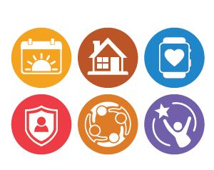

Holistic life domains
Life domains are the different aspects and experiences of life that we all consider as we age and grow.
These include: Daily Life & Employment, Community Living, Safety & Security, Healthy Living, Social & Spirituality, and Advocacy and Engagement.
Notes:
Another key principles of the framework is the Life Domains.
Read slide – first point
The LC has identified 6 life domain areas: Daily Life and Employment, community living, safety and security, healthy living, social and spirituality, advocacy and engagement.
Often times the service system tends to only focus on safety and security – keeping that person safe. And while that is very important (and it is a life domain identified) – we tend to leave out other important conversations about where that person wants to live, how are they going to get around, and being an active and responsible citizen.
As people, we all lead whole lives made up of specific, connected, and integrated life domains that are important to a good quality of life.

Slide 10

Supporting 3 buckets of need
The strategies for supporting individuals and their families can be organized into three categories (or buckets):
Discovery and Navigation: having the information and tools you need to navigate life
Connecting and Networking: making connections with peers and resources to help you navigate;
Goods and Services: the day-to-day tangible items you buy or use from public and private organizations in your community.
Notes:
Another principle is the 3 buckets of need and these are the strategies for supporting individuals and their families that include:
Read slide
These 3 buckets are something that we all need and can have access to whether you are receiving formal supports or not.

Slide 11

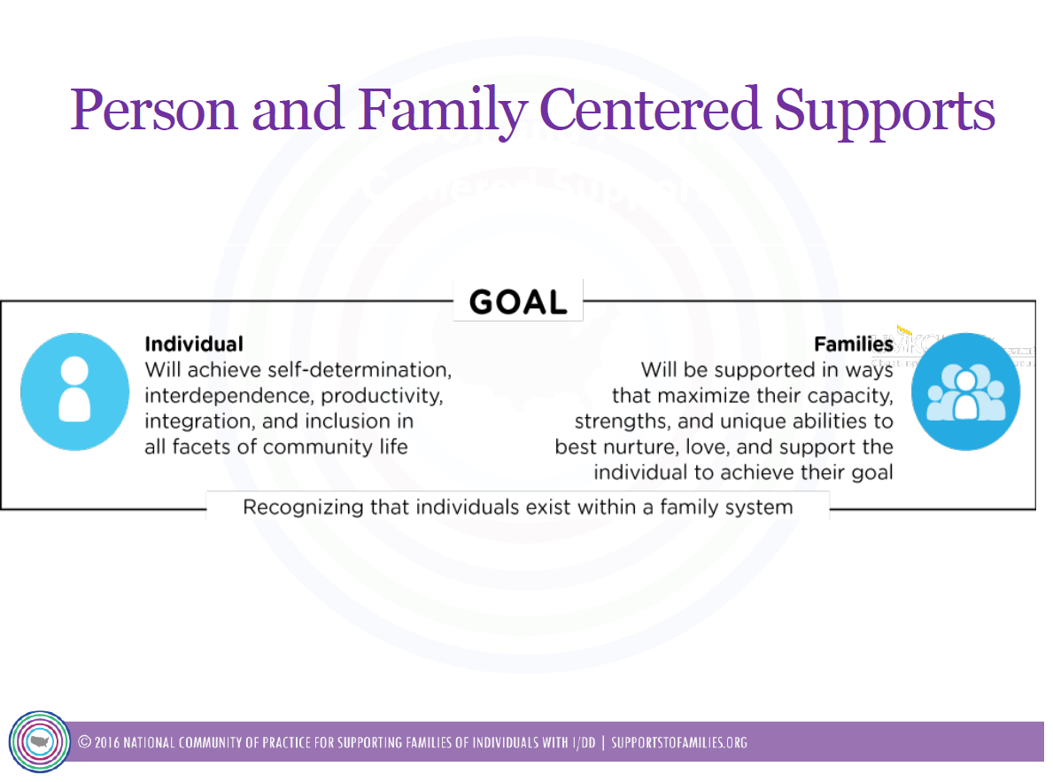
Notes:
By utilizing this framework the individual will….. And families will…..
And so this approach focuses both on person centered and family centered supports. Because again, the framework recognizes that individual exists within a family system that is defined by them

Slide 12
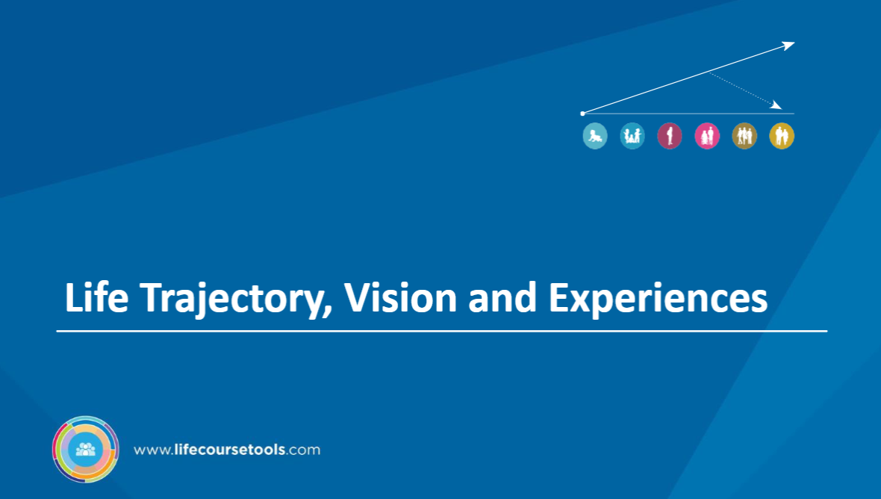
Notes:
I’m going to turn it over to Jan to talk about the trajectory, vision and experiences.

Slide 13
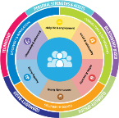
Vision for a Good Life
The future is not something we enter. The future is something that we create. And creating that future requires us to make choices and decisions that begin with a dream.
    -Leonard L. Sweet
Notes:
Really like this quote as it’s fitting for the concept of trajectory.
How can you plan with people if you don’t know their finish line? And so this concept is very important as we are supporting others.

Slide 14
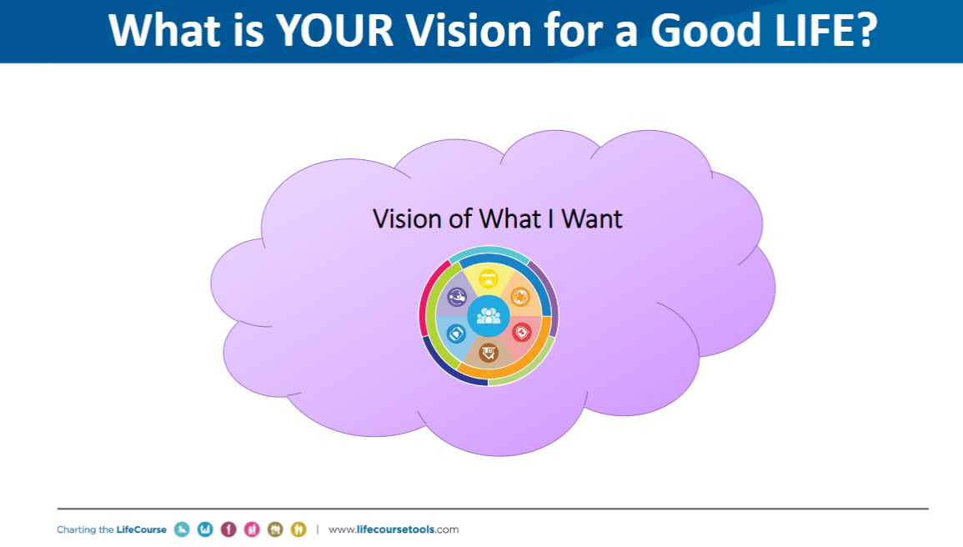
Notes:
The concept of trajectory begins with having a conversation about what people want in their life. What is their vision for a good life? What is going to give them meaning in their life?

Slide 15
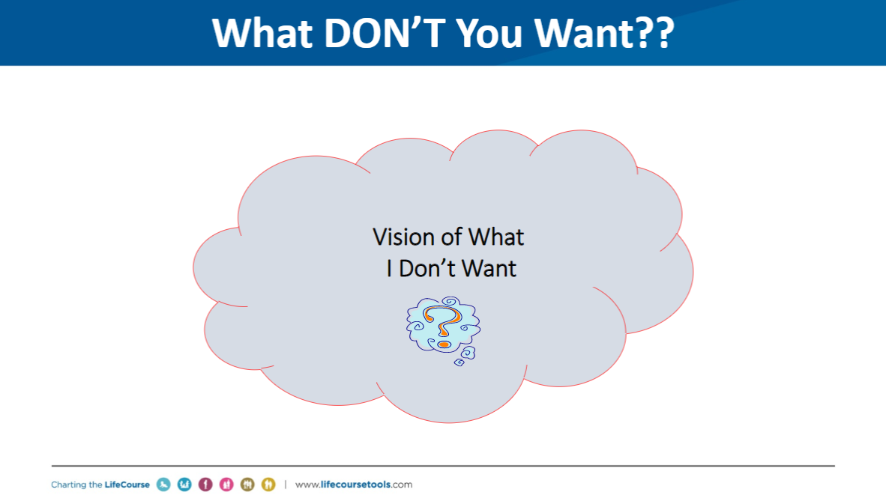
Notes:
And then having a conversation about what they don’t want in their life.

Slide 16
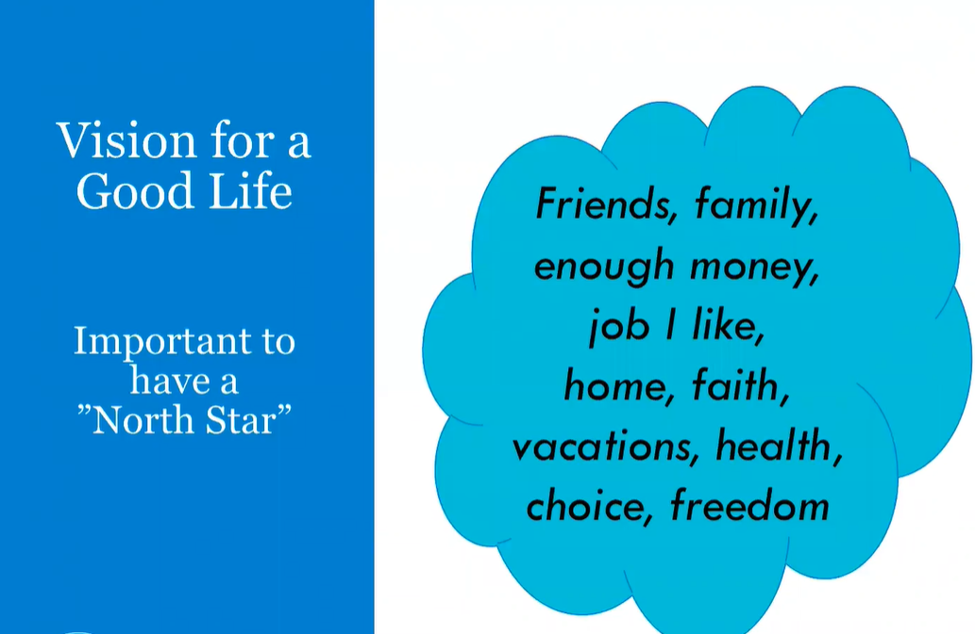
Notes:
Why is it so important to help pwd figure out what their vision for a good life is– how often talk to family member or pwd – unsure of what is really possible for what they want to do.
We have all of these Formal planning structures in place – whether in in school or getting Long term care services. We don’t take enough time to pause and say what is our north star – where are we heading.
Often times, We just right into the planning process – what are the outcomes , what are our action plans –don’t spend enough time figuring out what that person is working towards. what is their dream? Their vision?

Slide 17
Just as important...
Vision of What
IS NOT a Good Life
Vision for Good Life
Friends, family,
enough money,
job I like, home, faith, vacations, health, choice, freedom
Vision of What I Don’t Want
Notes:
What we have found with CtLC framework is that we have an opportunity to learn about people’s visions, not only as what they have described as their good life, but by also understanding what they don’t want. And why this is so important is that when you are having a conversation about what is your vision, and you see people hesitate, or you see a parent not being able to answer that questions, because maybe when they received the diagnoses – sometimes you lose the vision you had for your child and you haven’t replaced it with anything yet. So they may not be able to tell you what their vision is – but almost always they can tell you what they don’t’ want.
Very important spend time not only asking what is a vision of a good life for you but also tell me what you don’t want.
Sometimes you can start their first – what don’t you want for your future – or with a family - what don’t you want for your child
As professionals its your job to Define and understand what is possible for their vision of a good life

Slide 18
Trajectory towards Good Life
Vision for Good Life
Friends, family,
enough money,
job I like, home, faith, vacations, health, choice, freedom
Movement towards Vision
Vision of What I Don’t Want
Notes:
When we think about the concept, we think about that movement, that movement towards a vision – what is happening that impacts their life, what taking them to where they want to go and where they don’t’ want to go
Now we know where you are heading, what is it that we can plan, problem solve and help them get there.
Support coordinators, providers, DSP’s, VR counselors, teachers….. ALL have the power to impact someone’s trajectory, sometimes negatively, by their actions or words. We must be very careful and mindful of the impact we can have. Are we nudging person and family toward what they want or what they don’t want?? EACH interaction, think about which way it pointed their trajectory.
VISION and TRAJECTORY can be very broad or very specific and time limited. Might be what are we doing/what’s happening this week

Slide 19
Reflecting on Where I have Been….
to figure out where I need to go!!
Vision for Good Life
Friends, family,
enough money,
job I like, home, faith, vacations, health, choice, freedom
Things Happening NOW
Experiences from My PAST
Vision of What I Don’t Want
Notes:
Add another concept – start think about where you want to go and we need to plan along the trajectory – we also need to think about what you experienced in the past and did those experiences take you where you want to go, or where you didn’t want to go – we need to quickly understand those past experiences – and where you want to go in the future. If were’ going to figure out how

Slide 20
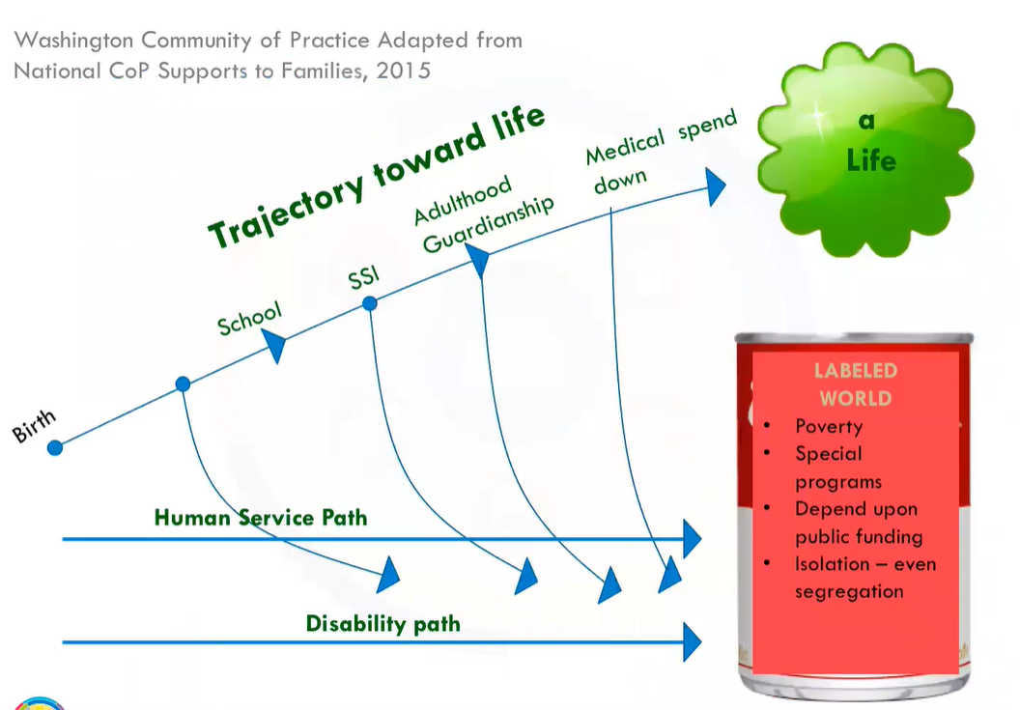
Notes:
This is a slide that the Washington CoP Utilized and they wanted to talk about trajectory in terms of different ways in thinking about disability and the different paths it can take you on.
Whether having a disability or not, People are going to move through life stages and a life span
And those with disabilities, because of their disability, they have to interact with different services. They may Interact with social serv, spec ed, disability service system –be careful of – some of our programming and cultures and policies are not pulling them down into exactly what they don’t want.
How can we work on policy and practice change and change the culture of those human service organization and disability organizations so that the programs themselves aren’t the programs that are let’s say causing poverty , creating segregation or creating a dependency on public funding. They utilized this to talk about what’s happening across the lifespan that may force a person into the direction that they don’t want to go

Slide 21






Trajectory Across Life Stages and Life Transitions
Life Transitions
And
Disability System Transitions
My parents have passed away, what do I do?
Parents Turn 65
Medicare & SSDI
Transition planning
Living Adult Life
Turning 18. Leaving school at 18 or 21
Leaving Early Childhood/ enter school
Getting New Diagnosis
Notes:
The other thing is , is that we incorporate the life stages at times as we talk about the trajectory. So sometimes we may not have a specific life stage and were ajust using the trajectory to not event talk about about a place in time but think about what happened in childhood, what do you want life to look like as an adults what is happening now.
Life Stages is another element of the concept of the Trajectory. You think about what is happening in early childhood, what do you want adulthood to look like and where are you now? We can’t ignore the life stages even though you may be focusing on the current situation. Think about what happened prior and also the stepping stones for the next life stage- they are all connected and build upon one another
When we think about life stages and life transitions, we often default to the formal transitions such as getting a diagnosis to entering early childhood and school and at 14 transition planning, moving into adult life…. But we really need to think about life transitions
But we need to think about what are other people without disabilities doing during those same life stages? DO they have chores, doing things in the community, hobbies.
Utilizing the trajectory helps people think about the life experiences that are happing and where they want to head. When you know where you want to head you begin to work on those skills or have those life experiences to help prepare you for that next life stage. So Knowing the past, knowing what to expect, what is coming, can be important.
Understand what where the past life experiences and what are some things we need to build into the future as you move through each of those life stages.
Help families to see the possibilities and have higher expectations because you start having different conversations.

Slide 22
Trajectory Across Life Experiences
Chores and allowance
Dating & Heartaches
Making Mistakes
Birthday parties with friends
Summer jobs, babysitting
Learning to say “no”
Playing sports or an instrument
Scouts, 4H, faith groups
“Anticipatory Guidance for Life Experiences”
https://www.youtube.com/watch?v=1wdNPlXsfCc
Notes:
As we know, life experiences prepare you for the next phase in your life.
Having chores as a child helps prepare you for employment. Having an allowance helps you learn about money (and making mistakes with money). Learning to say NO helps the person learn to protect themselves.
Utilizing the trajectory as a way to understand what were the past life experiences and what are some of the things you have to build into the future as you look at each of the life stages.

Slide 23
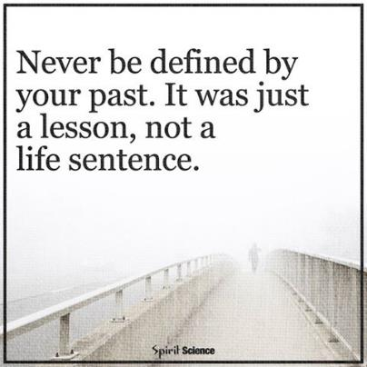
Dignity of Risk and Mistakes
Friends, family,
enough money,
job I like, home, faith, vacations, health, choice, freedom
Poverty, loneliness, segregation, restrictions, lack of choice, boredom
Notes:
The other think we want you to keep in mind – as important as it is to think about life experiences, that you are not defined by your past life experiences.
Working with pwd – whether own documentation– how long does a person have to live out a life sentence for that one experience that they did.
Give people with disabilities dignity of risks and making mistakes
Actual timeframe is set by you –
If working with a person in the system – talk about what do you want to achieve in this 6 months or this year – or what do we want to see when you get older
-People need to be allowed to take risks and make mistakes – and not pay for it forever. We all make mistakes, have consequences, and move past it – but PWD often are labeled or restricted for life if they make even a simple mistake. “fire-starter” “sexual predator” “can’t use the internet”
-Person doesn’t learn to STAY SAFE if someone is always protecting them from everything! Learn how to stay safe by having life experiences – learning to say NO; learning who to trust or not;

Slide 24
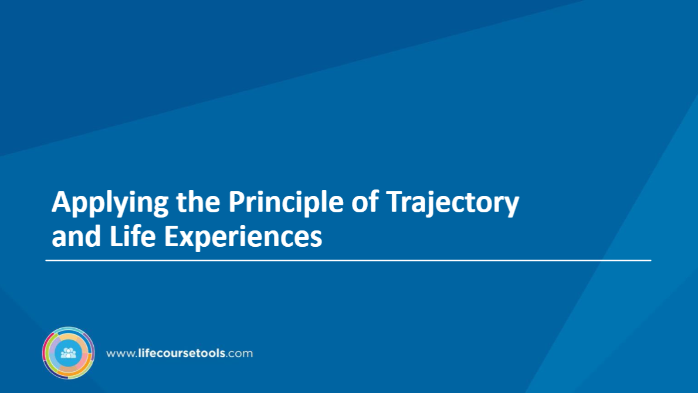
Notes:
Examples follow

Slide 25
What is the Purpose of the Trajectory?
Problem Solving
Working towards goals
Planning day-to-day activities
Being clear about what you want/don’t want
Understanding life experiences that either helped or were barriers
Strategic planning and implementation

Slide 26
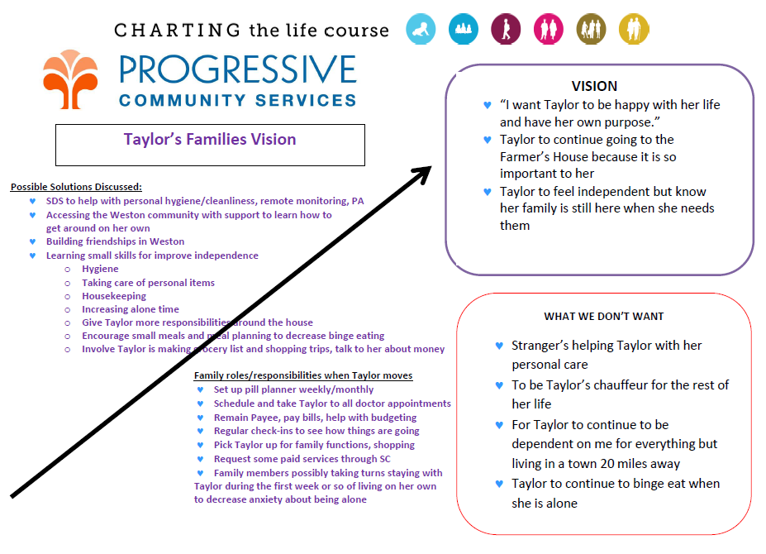
T’s Family – One Year Later
Notes:
These next few slides are examples on how others utilized the trajectory.
Example Taylor: tell me what your vision is and what you don’t want
Take notes to help Taylor stay on that trajectory and what are some of the things that the family needs to do. Adapted to meet their needs
Served Note taking and visual – reminder that the family had and professional had to go back and check this each time they met
It says 1 year later because they did a vision 1 year and 1 year later pulled out paper and compared those and had a conversation about it.

Slide 27
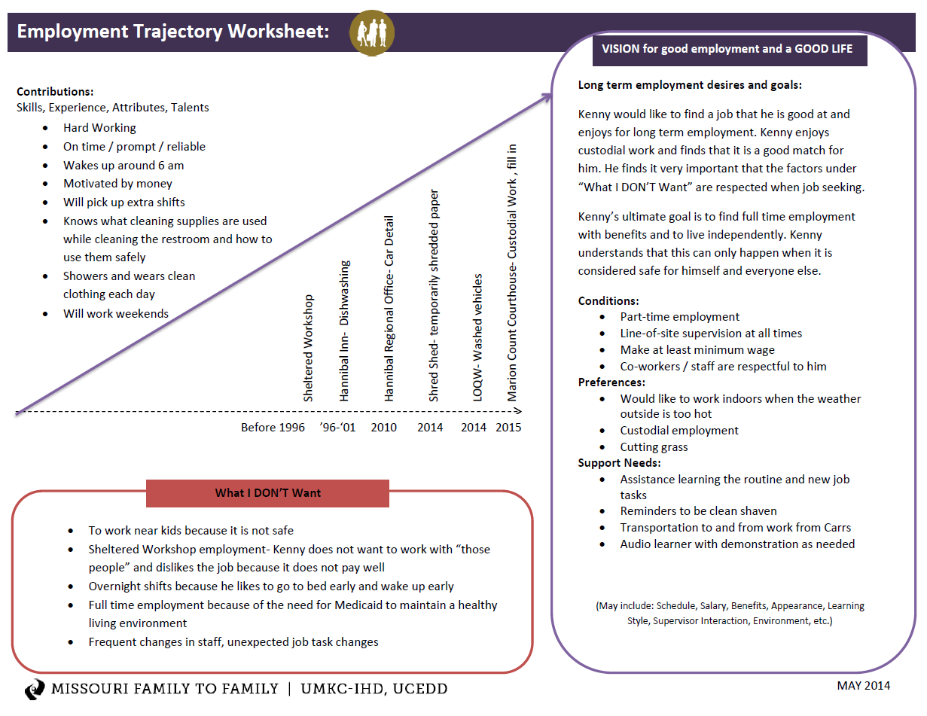
Trajectory for Employment Planning
Notes:
Used the timeline to talk about what this individual had done throughout his life experiences and they started to think about what are his contributions – where does he want to go with employment, and what are the things that he really doesn’t want as it relates to employment.

Slide 28
Trajectory for Planning Meetings
Notes:
This was developed specifically for planning for a formal planning meeting and prior to the meeting (what you’ll see on the right hand side) were things that the person said. I want money, I want friends, I want kids. This enabled the family to write down past life experiences- gave a snapshot on who this person was.
At the meeting Middle column was left blank so when they met as a team – they could say here is where she has been/ here is where she is headed – we work with you as a team to fill out what should be in the middle box in terms of goals for services you are going to provide – team approach – work on this years goals

Slide 29
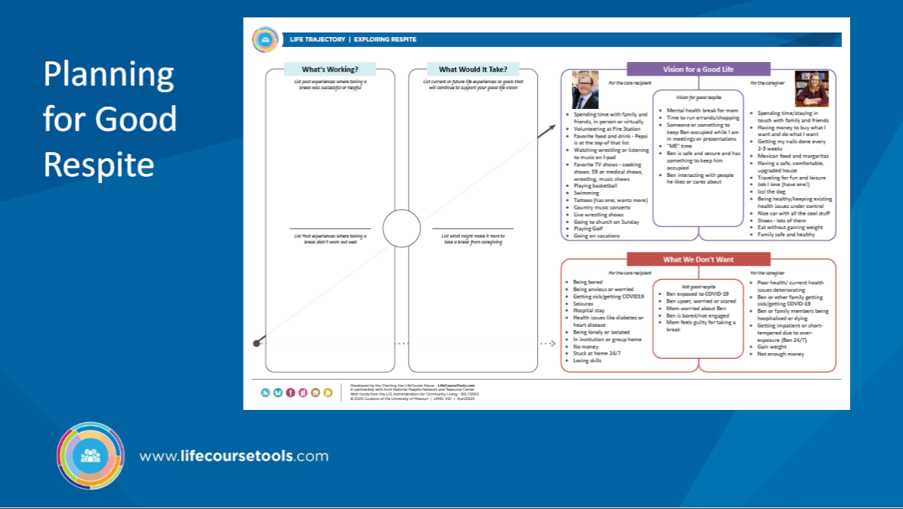
Notes:
Combines 2 things together – right had side – we need to know what a vision for a good life is for the caregiver and for the care recipient.
Need a vision for each one of them feels is good respite. How do we make sure we understand the person
What are some ways successfully taken breaks from one another – what didn’t work?
What does it take now to be successful

Slide 30
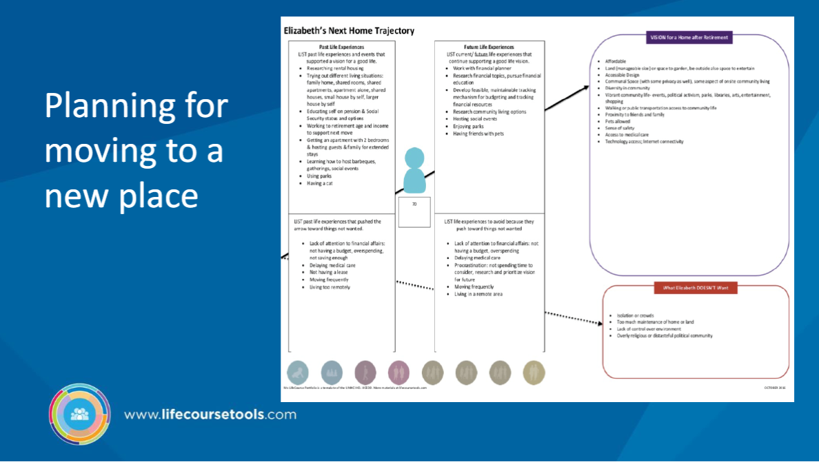

Slide 31
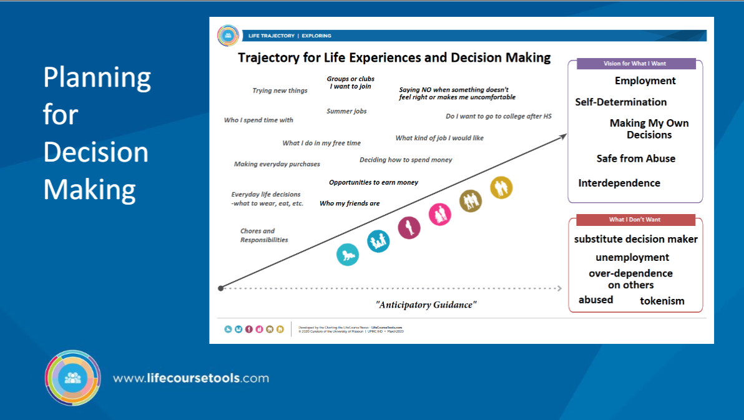
Notes:
All of the experiences they want to have to help them plan to make their own decisions. What skills and opportunities are needed to help them be a good decision-maker

Slide 32
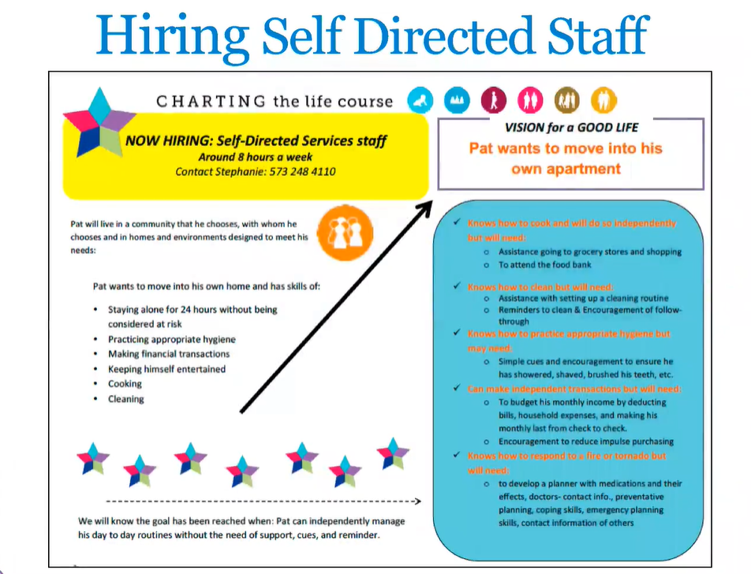
Notes:
Example of SA they wanted to talk about the staff they wanted to hire – use the trajectory to write a job description for what they wanted in a direct care staff. Listed out the things that the caregiver needed to do
incorporate and show that if you are going to work for Pat, these are the things you need to know.

Slide 33
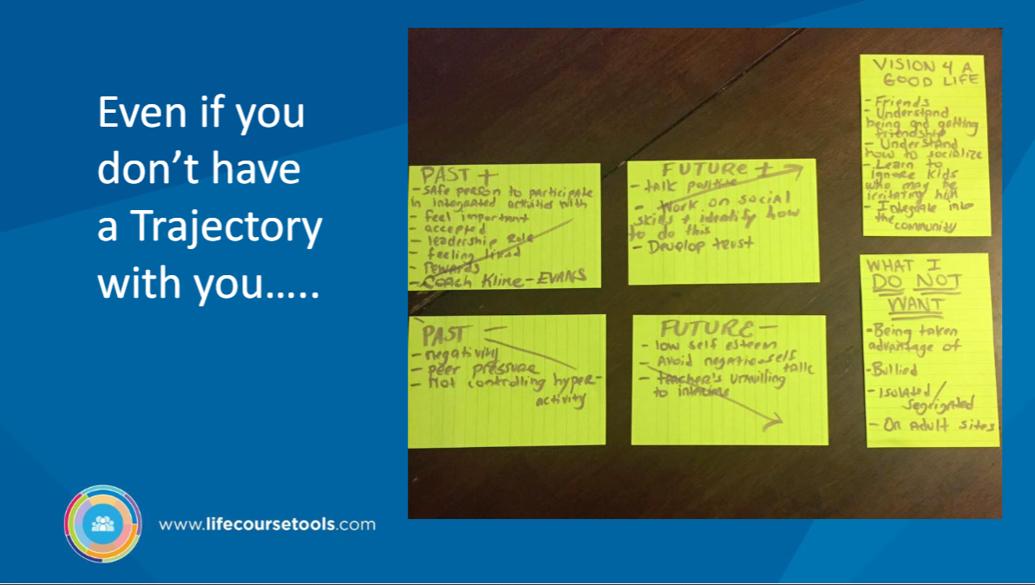
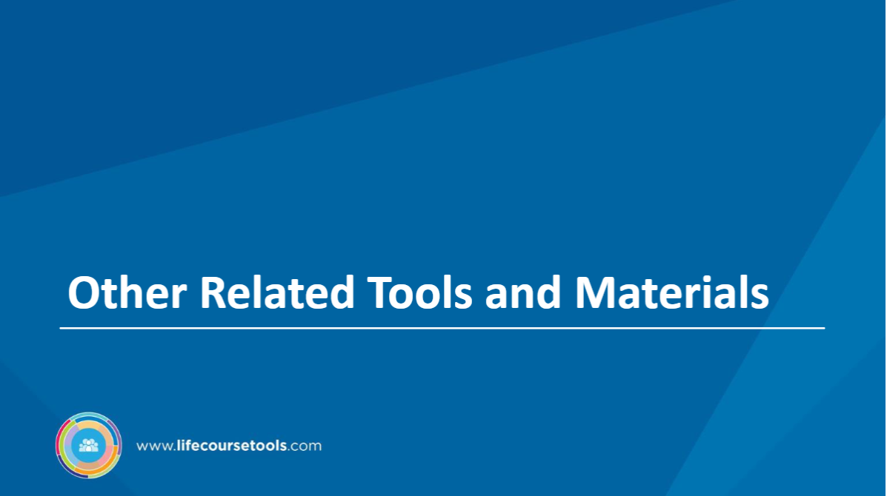

Slide 34
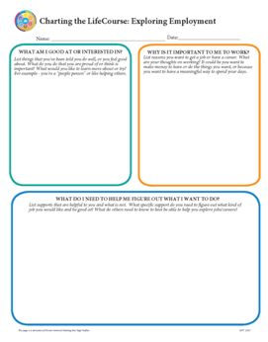
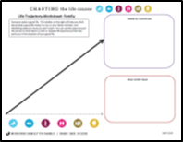

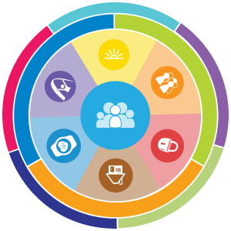
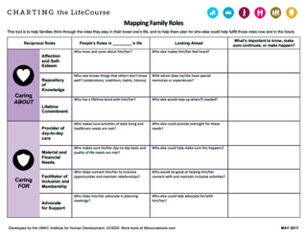
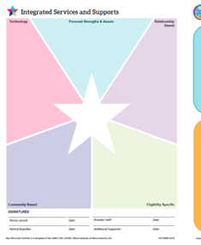
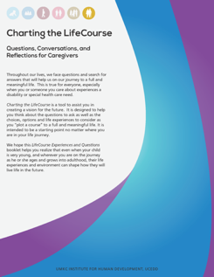
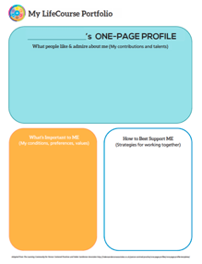
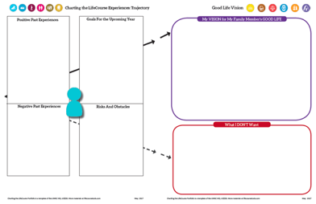


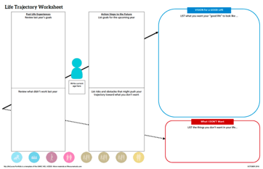
www.lifecoursetools.com
Planning for Life Outcomes and/or
Service Planning
Self-Advocate
Tools & Resources
Family Perspective
Tools
Formal Planning
Tools and Forms
Notes:
To learn more about the lifecourse, you can Visit lifecoursetools.com. There are several resources available and all of the tools are also available to download so I encourage you to check out that website.

Slide 35
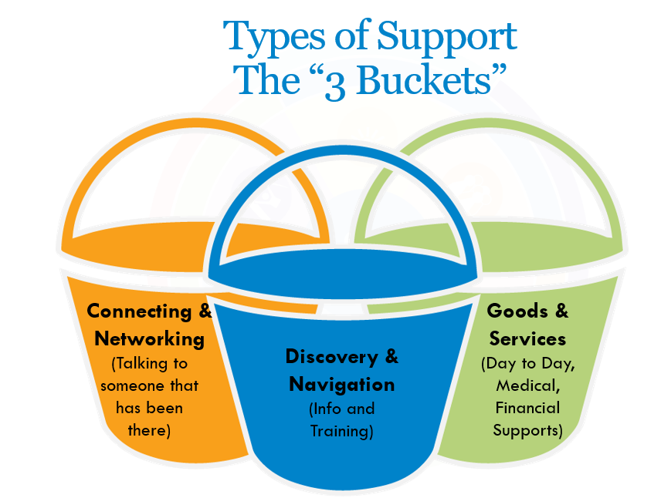
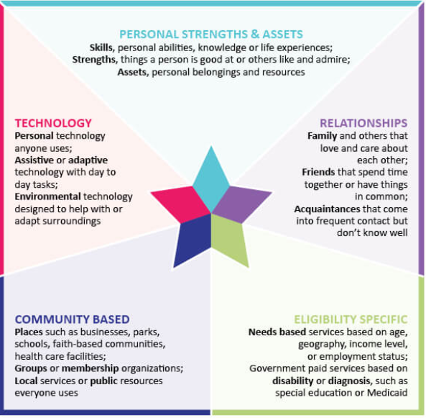
November 15 Webinar
Notes:
Next month we are focusing specifically on 2 of the LifeCourse principles - we are going to focus on the 3 buckets of support – so we’ll be taking a deeper dive into those 3 strategies and then also focusing the Integrated Supports Star. My colleague, Tedra Jackson will be presenting on this information.

Slide 36

Person-centered practice learning community
MI CoP for Supporting Families, in partnership with CMHAM, are forming a collaborative learning community to provide CMHSPs an opportunity to work collaboratively to transform and enhance person-centered planning practices and policy.
Members of the learning community will receive training, technical assistance, and the opportunity to connect with others through a two-year process designed to support ongoing transformation at the organizational and statewide level.
Teams will explore how to apply the principles to improve person-centered practices and will implement the framework and principles to advance person-centered practices within their organization.
Notes:
And the last thing that we wanted to share is
The Michigan Community of Practice for Supporting Families, in partnership with the Community Mental Health Association of Michigan, are forming a collaborative learning community to provide CMHSP’s) an opportunity to work collaboratively to transform and enhance person-centered planning practices and policy. Participants will also inform recommendations to MDHHS for statewide adoption.
Members of the learning community will receive training, technical assistance, and the opportunity to connect with others through a two-year process designed to support ongoing transformation at the organizational and statewide level.
In year one, teams will explore how to apply the lifecourse principles to improve person-centered practices and will implement the framework and principles to advance person-centered practices within their organization, including but not limited to, changes in policies, procedures and other systems change related to person-centered practice.

Slide 37
Person-centered practice learning community
Consist of 4 teams
Each team will include up to 5 staff members
There is no cost to participate
Two-year commitment beginning January 2023
Deadline to submit application: November 30
Informational Call: November 10th at 10:30am
Notes:
A maximum of 4 teams will be selected to participate in the learning community.
The Learning Community is a two-year commitment beginning January 2023. In year one, the community will spend 12 months learning the CtLC Framework Principles, implementing the principles with persons served, and refining goal(s). Year two will be a less intensive meeting schedule with organizations focusing to continue to implement the framework while making changes necessary in policy(s), procedure(s), and practice(s).
There is an application and the deadline to submit will be November 30th.
Our team we will be hosting an informational call to review the requirements of the learning community and answer questions. November 10th 10:30-11:30am.
The call for applications is going to out tomorrow that explains this learning community in full detail – along with the information and link to apply.
So look for that information.

Slide 38


